Slide 1


SHORTEST PATH PROBLEM
For Directed Unweighted and Directed Weighted Graphs
Use presentation in conjunction with video lecture & example screenshots.

Slide 2
UNWEIGHTED GRAPHS
Shortest path between two vertices, is the one with minimum number of edges between them.
The length / cost of a path in an unweighted graph is the number of edges in the path.
We use Breadth First Search to find the shortest path between two vertices.

Slide 3
BREADTH FIRST SEARCH ALGORITHM
Breadth First Search uses a Queue to find the shortest path (as you will remember from Graph traversal lecture)
To find shortest path in an unweighted graph between two vertices , we keep track of the following:
For each vertex V in G=(V,E)
Distance
Shortest distance from start vertex to V
Number of edges in the shortest path from start vertex to vertex V
Predecessor
Vertex that precedes vertex V in the shortest path from the start vertex to vertex V

Slide 4
BREADTH FIRST SEARCH ALGORITHM
Initialization
Set distance of all V to ∞ (or a very large number inside the program)
Set predecessor value of all V to -1 (assuming all vertices are numbered 0 to V-1)
Predecessor of the selected Start vertex is always -1 and distance value is 0
Every time a vertex V is inserted into the queue:
Change the predecessor Value
Distance = Distance +Distance of Predecessor
Shortest path from start vertex to any vertex can only be found, if the vertex is reachable from start.
Refer to Example of BFS

Slide 5
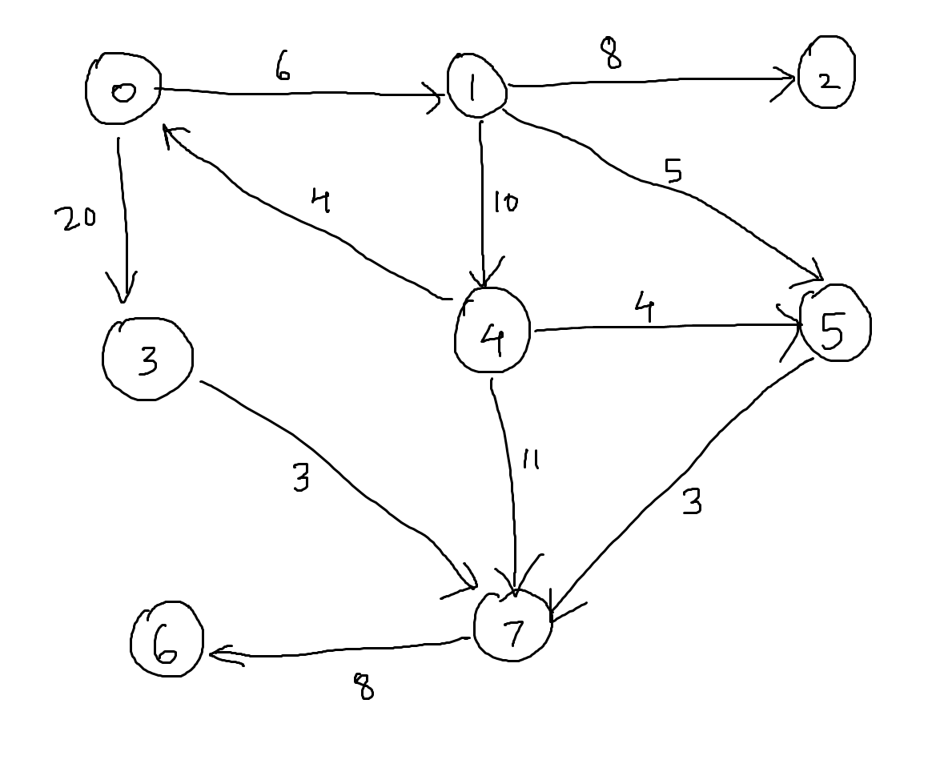
WEIGHTED GRAPHS
Shortest path - Sum of weights of the edges included in the path is minimum
0 -> 1 -> 4 -> 7
Cost: 28
0 -> 3 -> 7
Cost: 23
0-> 1 -> 4 -> 7
Cost: 14
The shortest path between 0 and 7 is of the cost 14.
Shortest path might not be unique we can have multiple path with same length.

Slide 6
APPLICATIONS
Transport System
Airline Network
Railway Tracks
Electric Supply
Water Distribution
Computer Networks

Slide 7
DIJKSTRA’s ALGORITHM
In this algorithm, a vertex is selected as the start vertex.
The result of the algorithm is the shortest path to every vertex V in the graph from the start vertex.
Just like the BFT, shortest path is calculate only for vertices reachable from the start vertex.
For Dijkstra’s algorithm all weights must be non negative
Dijkstra’s algorithm is a Greedy Approach algorithm.
Other algorithms for calculating shortest paths are
Bellman Ford’s algorithm
Floyd’s algorithm

Slide 8
DIJKSTRA’S ALGORITHM - Terminology
For each vertex in the graph:
Vertex Status
Temporary : Shortest path is not final, also labelled unknown / undiscovered.
Permanent : Shortest path is final, also labelled known / discovered.
Initially all vertices are temporary, in each step we will make a temporary vertex permanent.
Vertex Label
These values change many times during the algorithm when vertex is temporary(relabeling)
pathlength :
Temporary Vertex : length of the shortest path from source vertex to V (known till now) better path may exist.
Permanent Vertex : length of the shortest path from source vertex to V (finalized)
Initially path length is set to ∞
Predecessor :
Temporary Vertex : Predecessor of V in the shortest path (predecessor may change when better path is found)
Permanent Vertex: Predecessor of V in the shortest path (finalized)
Initially predecessor is set to NIL.

Slide 9
Dijkstra’s algorithm - initialization
For all vertices :
pathLength (PL) = ∞
predecessor (PD) = NIL
status = Temporary
For source vertex PL = 0

Slide 10
STEP 1
Find the temporary vertex with minimum PL
Change it’s status to permanent , make it currentVertex.
STEP 2
All temporary vertices adjacent to currentVertex are examined and relabeled if required
if PL(currentVertex) + weight (current, V) < PL(V)
PL(V) = PL(currentVertex) + weight (current, V)
PD(V) = currentVertex
else
No relabeling
STEP 3
Steps 1 & 2 are repeated till:
There are no temporary vertices left in the graph (All Vertices are discovered)
Remaining temporary vertices have PL = ∞ (these vertices are not reachable from the source vertex)
Refer to example of Dijkstra’s

Slide 11
ANALYSIS
Initialization : constant time per node
Inserting V vertices in heap takes O(V log V) time
Loop is performed O(V) – each time removeMin() is called O(logV)
Total O(VlogV) time
Update of cost / PL is O(E) times, updating in heap takes O(logV) time
Total O(ElogV) time
Total time taken = 2 O(VlogV) + O(ElogV) = O((V+E)log V)

